Slide 1
INTER-AMERICAN DRUG ABUSE
CONTROL COMMISSION
C I C A D
Secretariat for Multidimensional Security
SEVENTIETH REGULAR CICAD SESSION
November 16th-19th, 2021
Virtual Session
OEA/Ser.L/ XIV.2.70
CICAD/doc.2647/21
November 18, 2021
Textual
DIRECTOR GENERAL VAUGHN CHARLTON
PLENARY SESSION 5, PANEL 5
GENDER-BASED ANALYSIS PLUS GENDER MAINSTREAMING IN CANADA'S SECURITY AGENCIES

Slide 2
Gender-Based Analysis Plus
Gender mainstreaming in Canada’s security agencies
November 2021
Notes:
1

Slide 3
RCMP Mandate and Jurisdictions
Canada’s national police service, with mandates at the municipal, provincial/territorial, federal and international levels
30,000 Employees
19,000 Regular Members (police officers)
3,400 Civilian Members
7,600 Public Service employees
Deliver front-line policing services in 8 provinces, 3 territories, 150 municipalities, 600 Indigenous communities and 3 international airports
2

Slide 4
Diversity in the RCMP
RCMP Employee Employment Equity Group (As of April 1, 2018)
Category of Employee | % Women | % Visible Minority | % Indigenous | % Persons with Disability
Regular Members** | 21.6% | 11.1% | 7.8% | 1.7%
Civilian Members | 51.7% | 13.6% | 3.9% | 2.7%
Public Service Employees*** | 77.6% | 13.7% | 5.7% | 4.1%
Total for RCMP | 39.5% | 12.0% | 6.8% | 2.4%

Slide 5
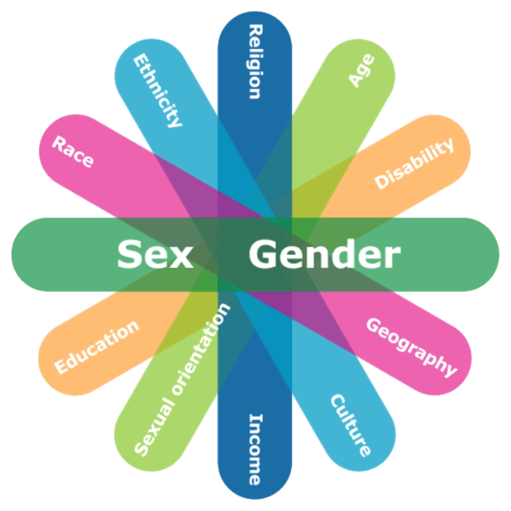
Government of Canada Commitment to GBA+
Gender-based Analysis Plus (GBA+) is an analytical approach tool to examine how diverse groups may experience policies, programs and initiatives
Groups are not homogenous; “good” analysis requires considering numerous other identity factors
2

Slide 6
GBA+ at the RCMP
RCMP Commissioner has been tasked with transforming and modernizing the RCMP
GBA+ is being used as a key tool to modernize the organization
Helps us to look at issues and objectives from different point of view
Positioned under a new RCMP Action, Innovation and Modernization (AIM) unit
Includes a dedicated RCMP GBA+ unit with full-time employees
GBA+ being used to examine internal and external issues:
Diversity of the workforce, workplace policies
Uniform and equipment
Culture change – addressing systemic issues
Enhancing community relationships and public trust
Addressing modern forms of criminality

Slide 7
GBA+ has been applied to:
RCMP recruitment process to identify barriers to diverse applicants
Impact of requirements on different groups: E.g.: the need to possess a driver’s license, use of polygraph testing
Impact of paramilitary aspects of training
Examine the procurement of new body-worn cameras
Usability by diverse officers, impact on diverse communities
Supplier diversity in procurement
Design of facilities and police detachments
Ensuring accessibility, inclusion of trans or non-binary people
Cannabis legalization – examining how groups may be impacted

Slide 8
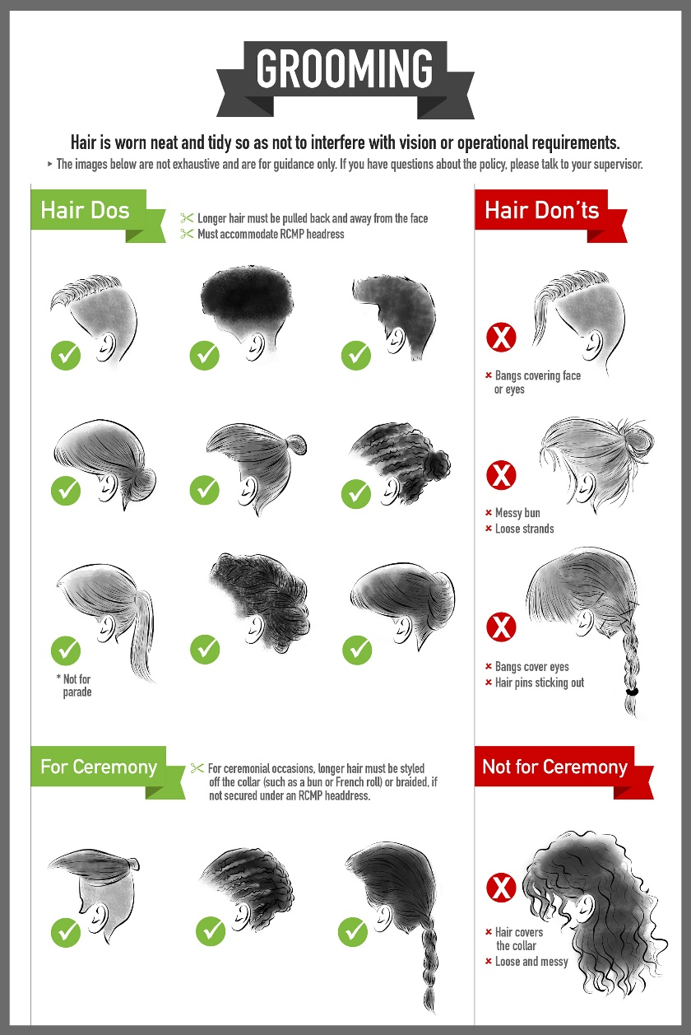
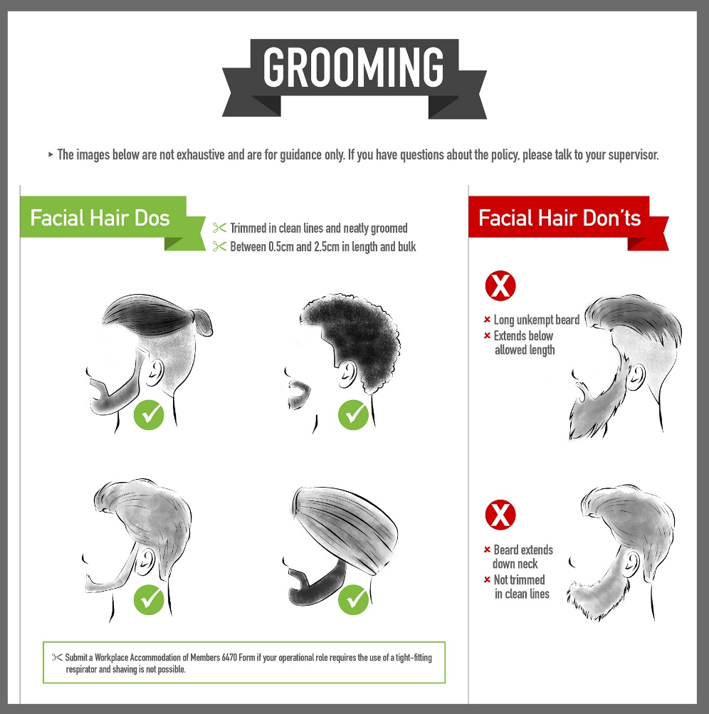
Updated grooming

Slide 9
GBA+ results
Addressing systemic barriers contributes to more diverse employees, and greater public trust
GBA+ can help to identify small but meaningful changes that improve morale and create more efficient and effective workplaces
Federal Policing program looking at new ways to recruit civilian investigators
Investigative capacity enhanced by greater diversity
Modern criminal landscape requires specialized skillsets

Slide 10
Keys to Building GBA+ Capacity
Awareness and training
Introduction to GBA+ online course on Department for Women and Gender Equality website
2-hour free web-based interactive course in English and French
Introduces key concepts, definitions and processes
Case studies on the use of GBA+ in government
Identify a Gender Focal Point or GBA+ Advisor to become internal experts
Ensure GBA+ is a formal part of senior decision-making process
Facilitate access to data and new research

Slide 11
Questions?
Contact Information:
Vaughn Charlton
Director General
Action, Innovation and Modernization
Royal Canadian Mounted Police
vaughn.charlton@rcmp-grc.gc.ca

